Slide 1
Building and provisioning genomics platforms on the world’s clouds
Enis Afgan
Johns Hopkins University
Galaxy Project
April 2016, University of Heidelberg

Slide 2
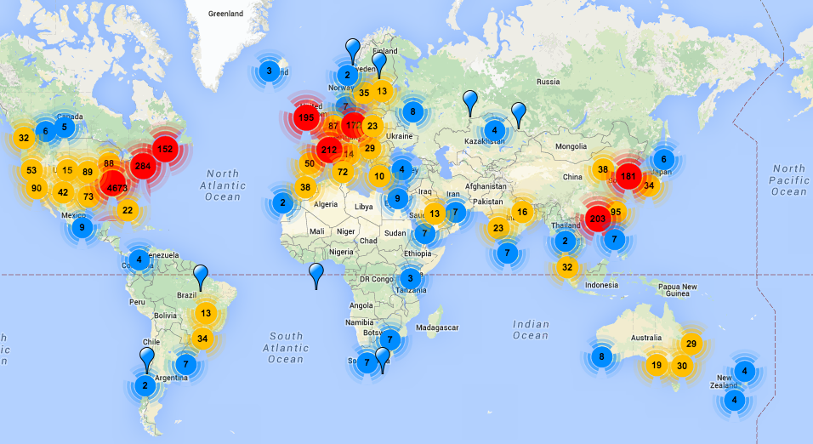
We’ve all seen this map
omicsmaps.com

Slide 3

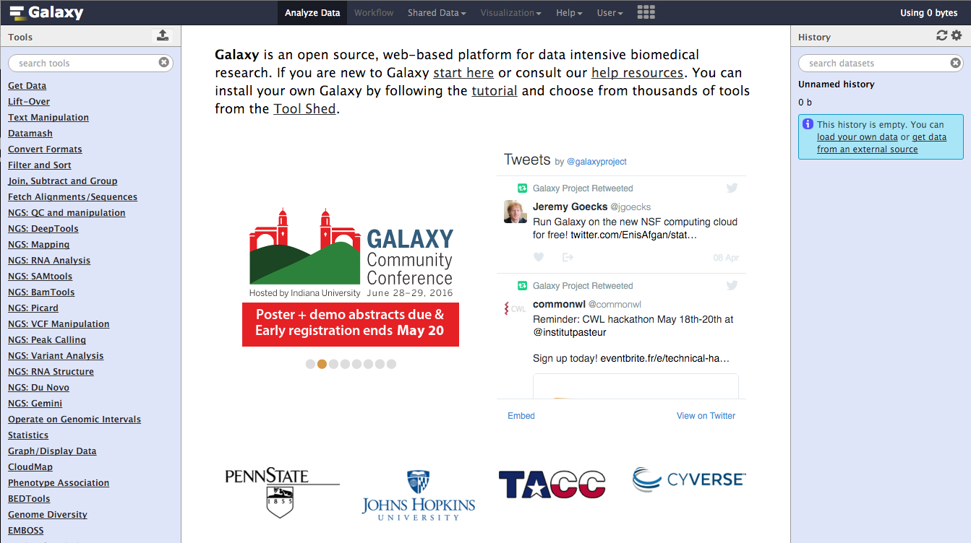
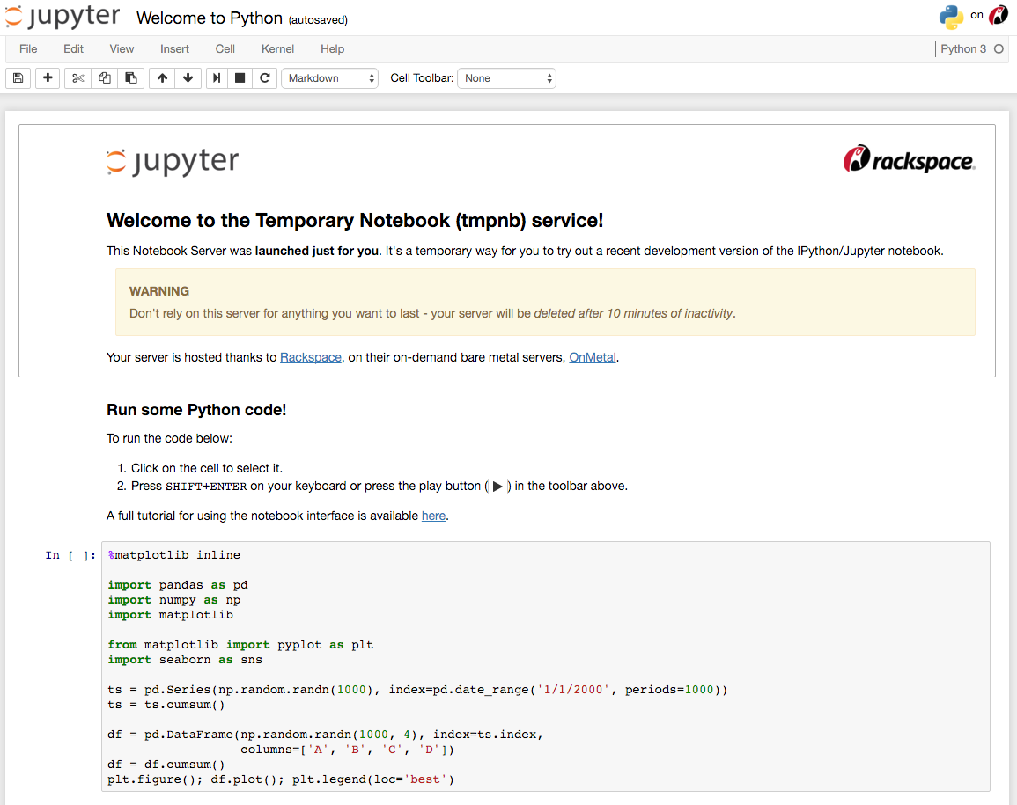
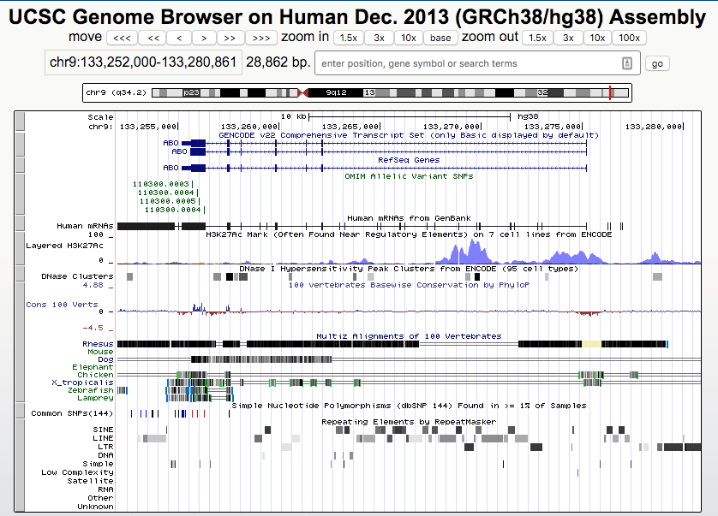
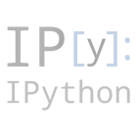
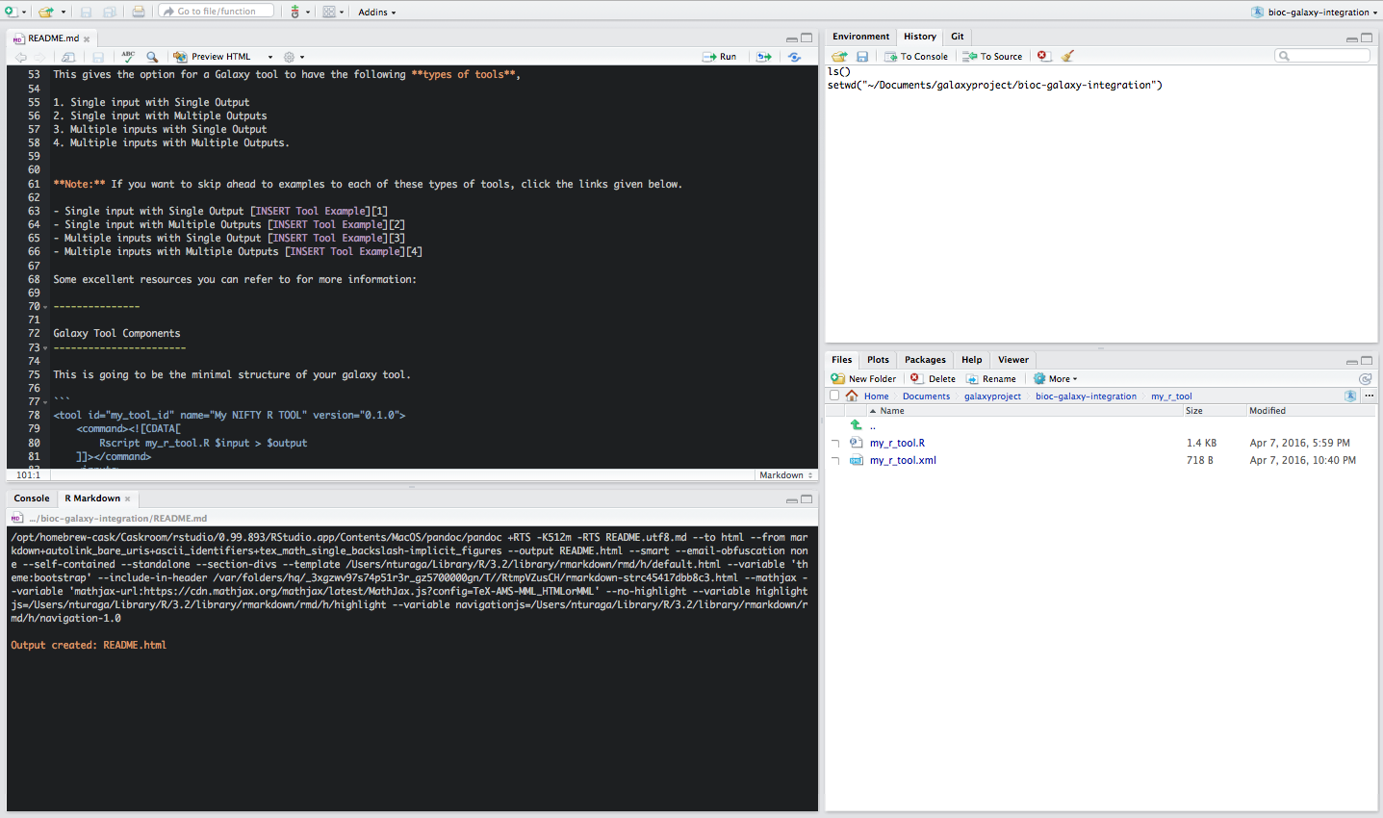


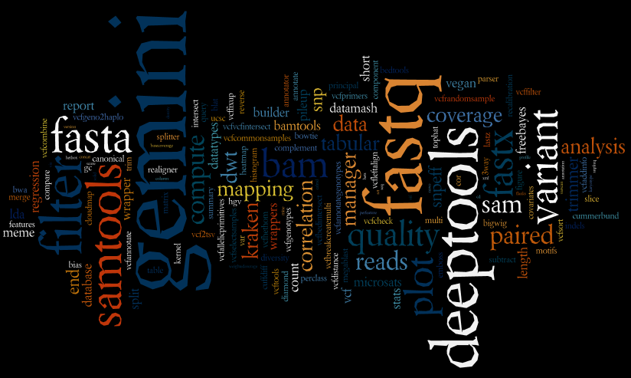
Data analysis solutions exist

Slide 4
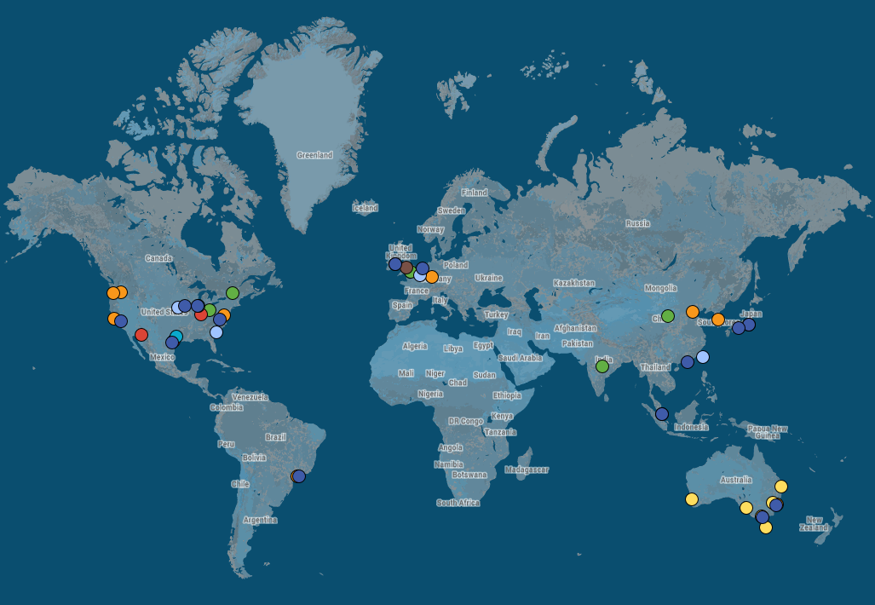
World’s clouds
AWS
AWS (coming soon)
Azure
Chameleon
Google Compute Engine
Jetstream
NeCTAR

Slide 5
Capacity without end-to-end solution

Slide 6

How to appropriately utilize clouds?
VM
Platform
Service

Slide 7
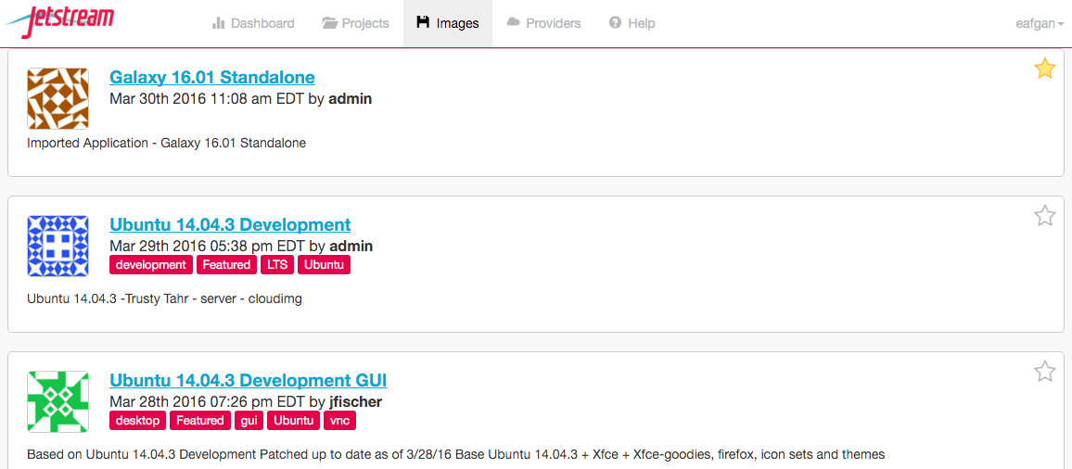
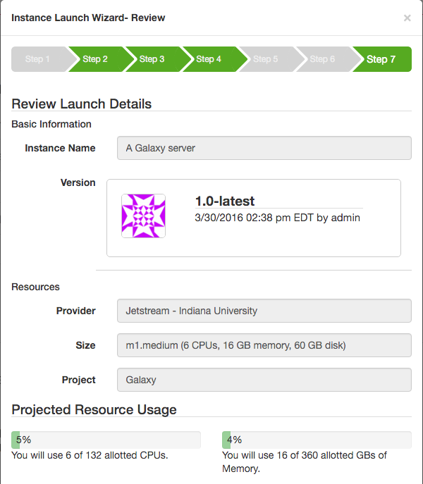
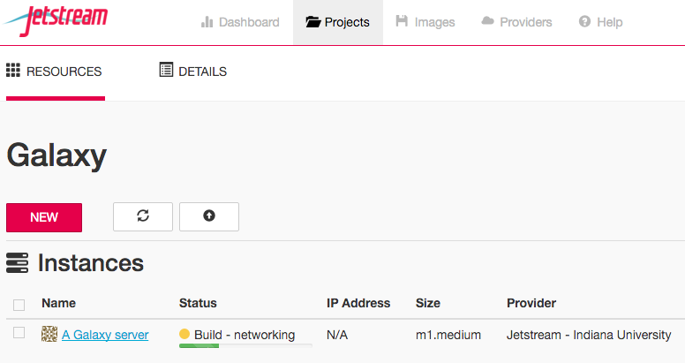
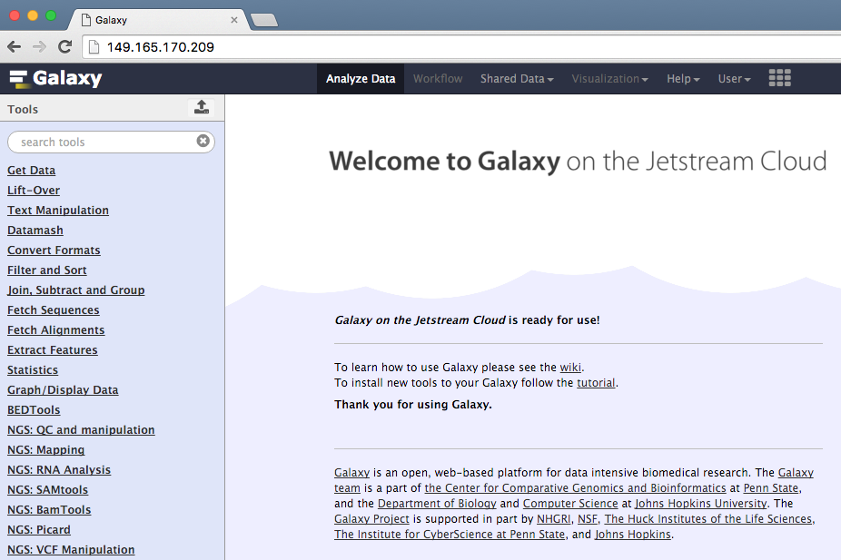
Standalone VM
[+] Easy to build; easy to deploy
[+] Low cloud system requirements ⟶ Transferable
[-] Limited capacity
⇀
⇀
⇀
1
2
3
wiki.galaxyproject.org/Cloud/Jetstream

Slide 8

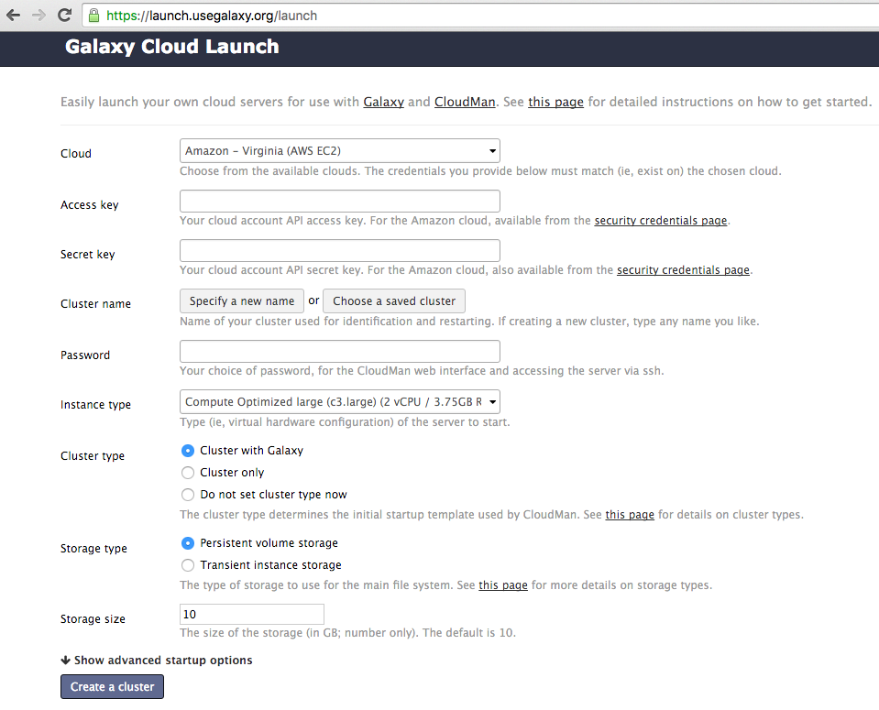
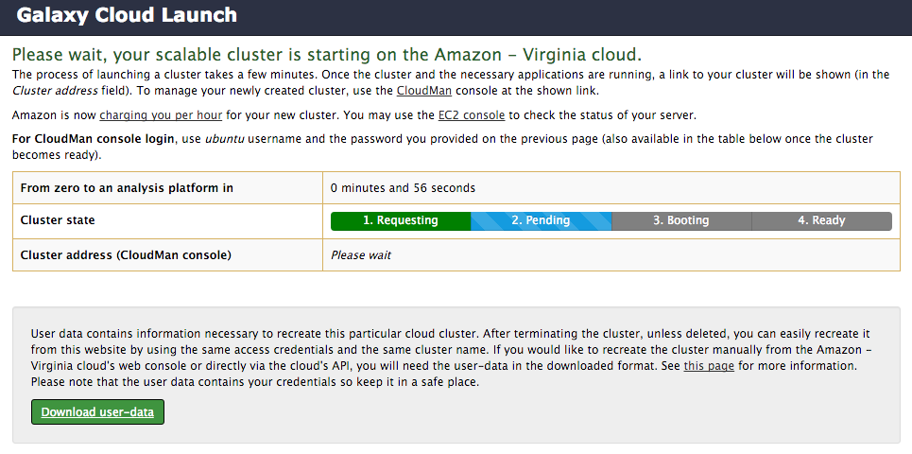
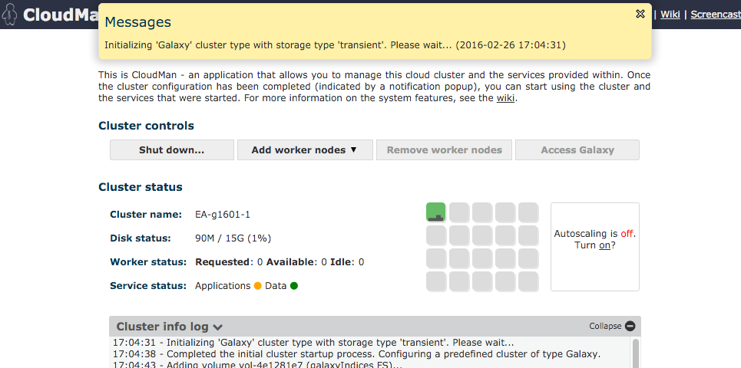
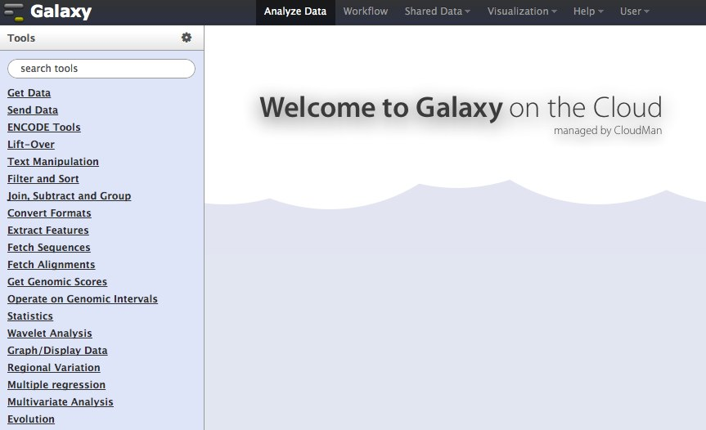


Scalable platform
Set up a virtual cluster across multiple VMs with app services
[+] Dynamically scale compute and storage
[+] Higher-level services: persistent storage, sharing, multi-application
[-] Complicated build; considerable infrastructure requirements
⇀
⇀
⇀
1
2
3
Galaxy FS
Ref data
gFS
rFS
launch.usegalaxy.org
wiki.galaxyproject.org/CloudMan

Slide 9
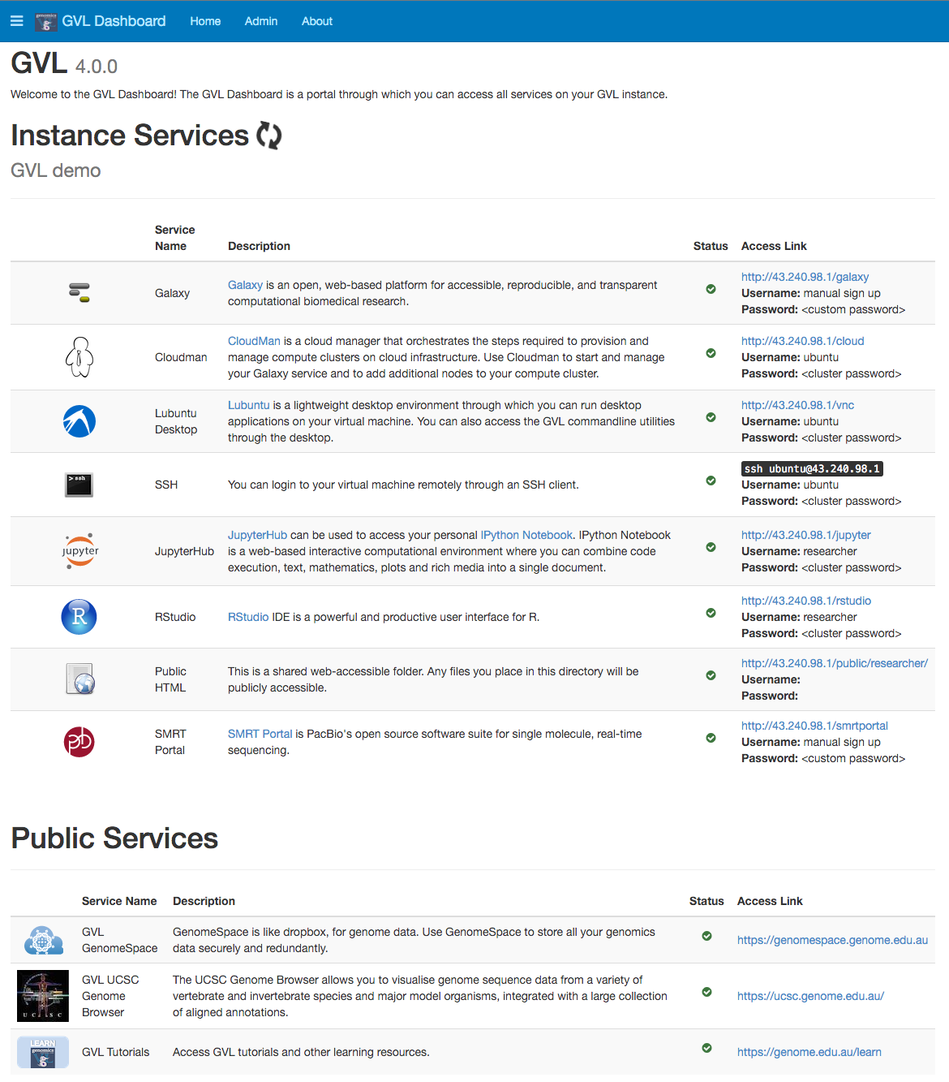
Scalable platform (cont)
Data analysis spans more than one application (even if that’s Galaxy)
Meet Genomics Virtual Lab (GVL)
[+] Versatile platform built on the scalable CloudMan cluster
[+] Includes common tutorials
[-] Demanding to build
[-] Calls for more customization
genome.edu.au

Slide 10




Ready-to-use service
Use cloud resources from an always-on, public service
[+] Visit usegalaxy.org and start computing – no setup required
[-] User quotas still apply
[-] It’s still a public service: no user customization
job_conf.xml
NFS
usegalaxy.org
CVMFS

Slide 11
There’s a lot of clouds out there…
AWS
AWS (coming soon)
Azure
Chameleon
Google Compute Engine
Jetstream
NeCTAR

Slide 12

How to appropriately utilize many clouds?
VM
Platform
Service
Build system

Slide 13
Adjustable build system
Automate the process of building each component
Codify knowledge about the system ⟶ easier to reproduce
Use Ansible as the technology of choice
Systems from configurable and reusable roles
Galaxy-Kickstarter
Playbook
Galaxy-CloudMan
Playbook
Use-Galaxy
Playbook
artbio.github.io/ansible-artimed/
github.com/galaxyproject/
galaxy-cloudman-playbook
github.com/galaxyproject/
usegalaxy-playbook

Slide 14





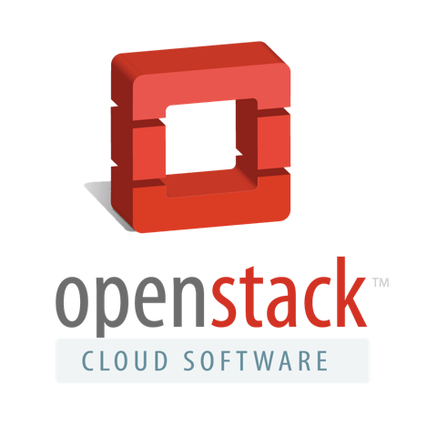

Many clouds AND many solutions
!?!
launch.genome.edu.au ; use.jetstream-cloud.org ; launch.usegalaxy.org

Slide 15
CloudBridge (future)
A Simple Cross-Cloud Python Library
Offer a uniform API irrespective of the underlying provider
Provide a set of conformance tests for all supported clouds
Focus on mature clouds with a required minimal set of features
Be as thin as possible
Support for AWS and OpenStack; Google Cloud under development
cloudbridge.readthedocs.org

Slide 16

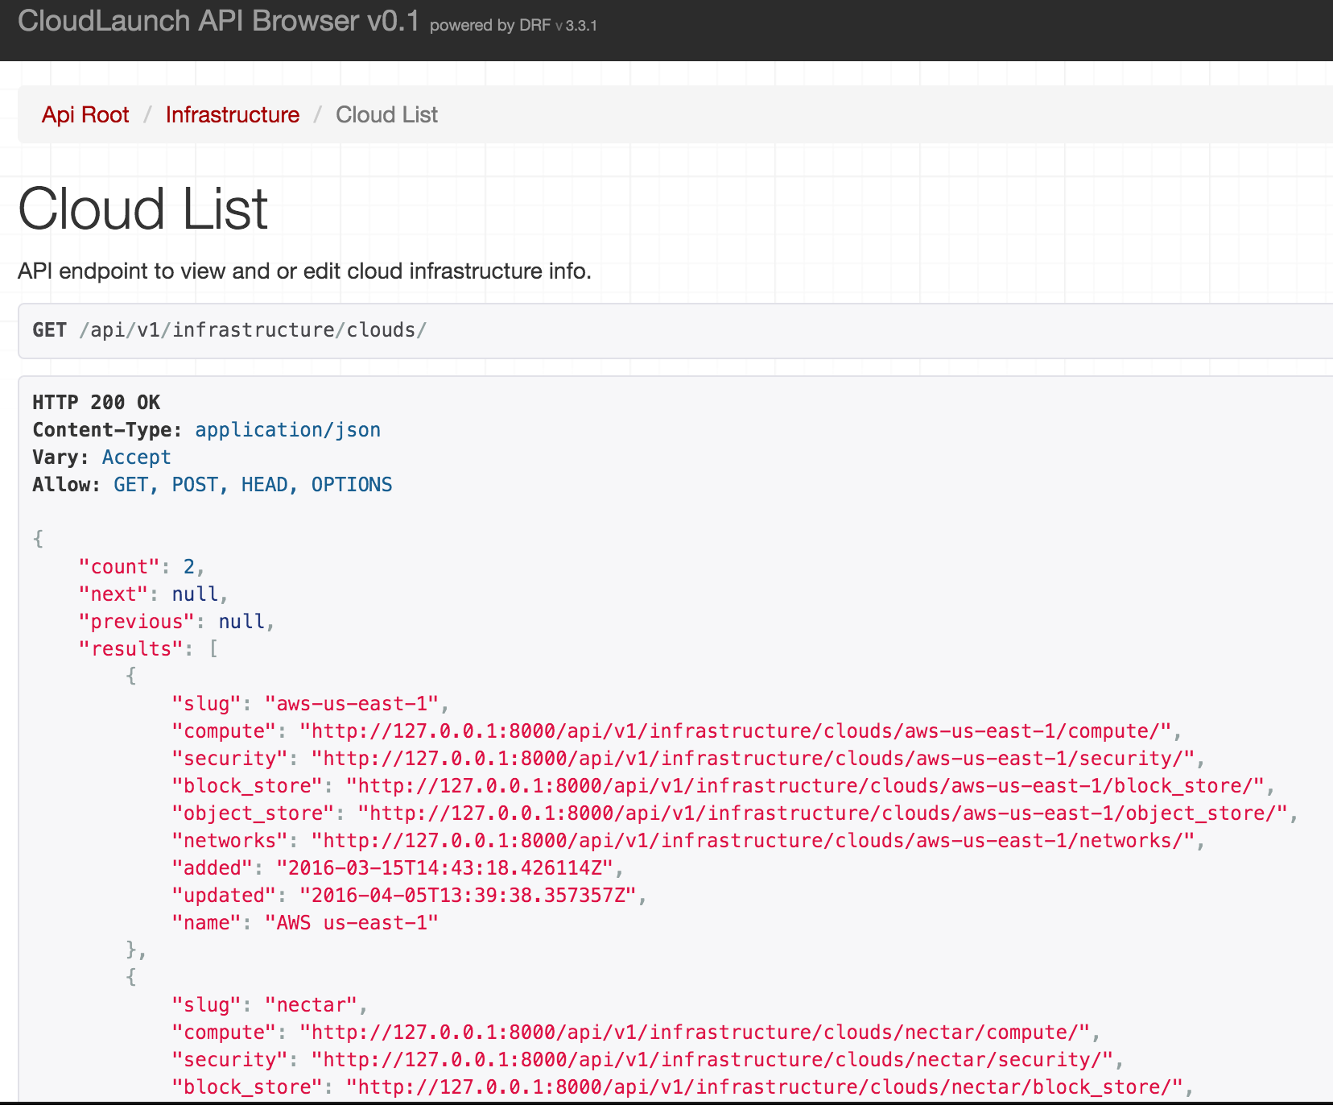
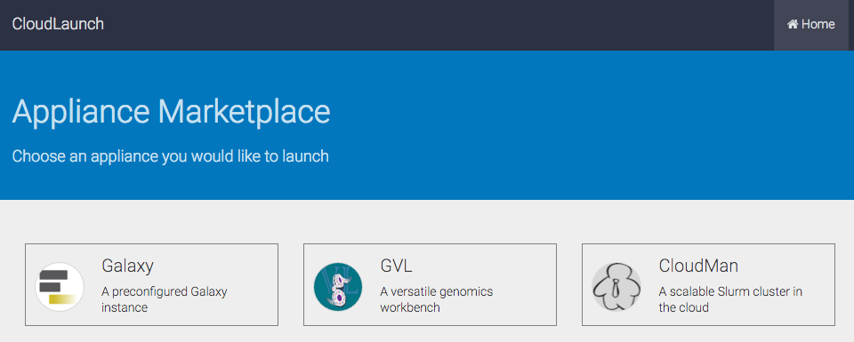
CloudLaunch (future)
ReST API driven launcher – with a UI: launch any app, on any cloud
User login; configurable applications (even by users); view and launch shared instances; multi-cloud dashboard view

Slide 17
CloudMan (future)
Resource manager with configurable service layer
Pull away from low-level application service management
Leverage containers to supply services
Allow runtime service and configuration changes
Run on any infrastructure, including high-level services, such as ECS, or Docker API
Goal: Launch a (template-based) CloudMan platform and add application services as desired from Dockerhub or similar while resource provisioning is automatically handled.

Slide 18
Galaxy ObjectStore (future)
Allow uniform any-Galaxy computing (i.e., make Galaxy instances interchangeable and disposable)
Galaxy implements an ObjectStore interface as an abstraction to data
Leverage it do expand user data storage and allow any Galaxy to connect to a user’s bucket
Harden S3 and Swift implementations; add per-user configuration
Use ObjectStore for reference data
Still will need to deal with the database dependency

Slide 19
The endgame?
ObjectStore
launch.usegalaxy.org
A
P
P
L
I
C
A
T
I
O
N
S
CloudMan
CloudBridge

Slide 20




Acknowledgments

Slide 21


Want more Galaxy?
gcc2016.iu.edu

